Slide 1
Endodontics Lecture 7
Microbiology in Endodontics
By
Abdullah Mohammed Al Jawher
B.D.S. M.Sc. (conservative)

Slide 2
Root canal microbes
More than 400 different microbial species have been found in infected root canals, usually in combinations. Fungi have been occasionally found in endodontic infections.
The most prevalent named bacterial species detected in primary infections:
1-Gram-negative bacteria: Fusobacterium, Porphyromonas, Prevotella,
2-Gram-positive bacteria: Actinomyces, Peptostreptococcus, Streptococcus, and Eubacterium bacteria.

Slide 3
Nutrition of Bacteria
The main sources of nutrients for bacteria colonizing the root canal system include:
(1) Necrotic pulp tissue.
(2) Proteins and glycoproteins from tissue fluids and exudate that seep into the root canal system via apical and lateral foramens.
(3) Components of saliva that penetrate coronally into the root canal.
(4) Products of the metabolism of other bacteria.

Slide 4
Modes of entry for bacteria to the pulp:
1- Through the carious cavity.
2- Through the dentinal tubules as in contamination during cavity preparation, through exposed root surface, and surfaces with erosion, abrasion and attrition.
3- Through the apical foramen as in advanced periodontitis where microorganisms reach the apical foramen and then the pulp.
4- Through the blood stream (anachoresis). Following trauma or inflammation to the pulp any bacteria in the blood might be attracted to the pulp causing pulpitis.
5- Through faulty tooth restoration.
6- Through extension of a periapical infection from adjacent infected tooth.

Slide 5
Host-parasite interaction
This interaction depends on:
1- Microbial virulence factors
These are microbial products, structural components, or strategies (biofilm formation) in the microorganism that gives it the capability to cause tissue damage.
2- Host resistance factors
Platelet factors, Serum factors as antibodies (IgG, IgM), Leukocytic factors as lysozymes which hydrolyzes bacterial cell wall of Gram +ve bacteria, Macrophages factors, Lymphocytic factors as lymphotoxin and macrophage activating factor. Salivary factors as lysozyme, antibodies (IgA)

Slide 6
Spread of bacteria in the body
1- Bacteremia
Bacteria especially alpha hemolytic streptococci can enter the bloodstream during routine dental treatment. In normal person the bacteria are killed within 10 minutes by the body defense mechanism.
Infective endocarditis happens in bacteremia to patients with a history of rheumatic fever, with cardiac murmur or mitral valve prolapse.
2- Septicemia
It is a serious life-threatening bacterial (and their products) invasion of the bloodstream. It happens when body defense is low or when the infection overwhelming. It is associated with severe signs and symptoms.

Slide 7
3- Cellulitis
It is an acute infection of the alveolar and loose connective tissue and it is a diffused spread of infection.
Clinically in endodontics cellulitis is called flare-up and it happens:
During access opening because of the environmental change of oxygen level in the root canal which enhances the action of the facultative bacteria.
During instrumentation and obturation when debris or obturation material extrude the apical foramen.

Slide 8
Bacterial culturing in endodontics
There are three reasons for culturing root canal contents:
1- To determine the bacteriologic status of the root canal.
2- To assess the efficiency of the debridement procedure.
3- To isolate microbial flora for antibiotic sensitivity and resistance profiles in cases of persistent infections.

Slide 9
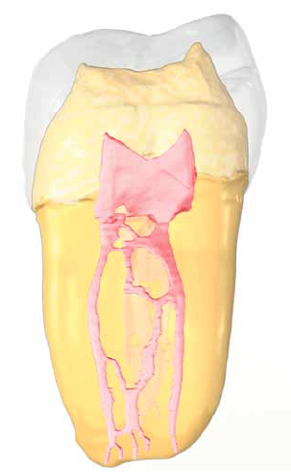
Irrigation in Endodontics
Every root canal system has spaces that can not be cleaned mechanichally .
The only way to clean webs, fins and anastomoses is through effective use of irrigation solution.
in order to get the maximum efficiency from irrigant , irrigant must reach the apical portion of the canal .

Slide 10
Properties of ideal irrigant solution
Anti microbial properties
Tissue solvent.
Flush debris.
Lubricant.
Eliminate the smear layer.
Low toxicity level
Notes:
Ideal irrigant should have all or most of this positive properties.

Slide 11
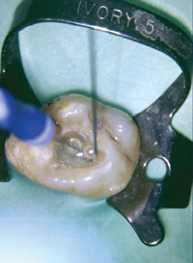
COMMONLY USED IRRIGATING SOLUTIONS

Slide 12
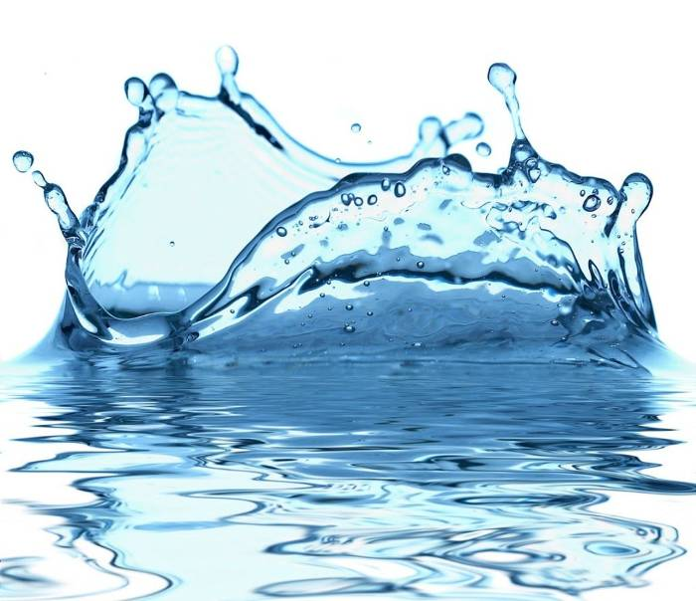
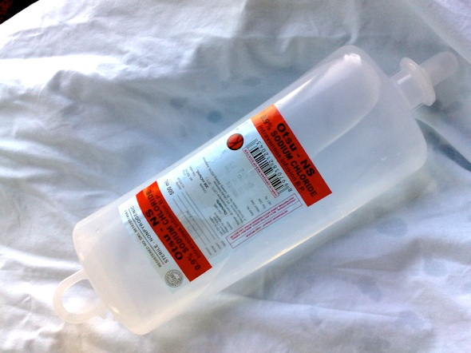
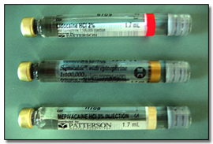
I.Chemically non active solution:
Water.
Saline.
Anesthesia.

Slide 13
I.Chemically non active solution:
Anti microbial properties
Tissue solvent.
Flush debris.
Lubricant.
Eliminate the smear layer.
Low toxicity level

Slide 14
II.Chemically active materials :
Alkalis : sodium hypochlorite
Antibacterial agents : chlorhexidin
Oxidizing agents: hydrogen prioxide
Chelating agents: EDTA ( ethylene diamine tetra acetic acid)

Slide 15
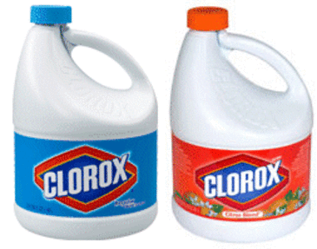
Sodium hypochlorite (NaOcl)
Clear ,pale green-yellow liquid with strong odor of chlorine .
It is a potent antimicrobial agent, killing most bacteria instantly on direct contact. It also effectively dissolves necrotic and vital pulp tissue.
The most advocated irrigant,inexpensive and readily available.
Notes:
Effective aginst microorganisms which are difficult to eradicate from root canals, such as Enterococcus, Actinomyces, and Candida organisms

Slide 16
Sodium hypochlorite (NaOcl)
Anti microbial properties
Tissue solvent. ( dissolve vital and non vital tissue)
Flush debris.
Lubricant.
Eliminate the smear layer.
Low toxicity level.

Slide 17
Concentration
NaOCl is commonly used in concentrations between 0.5% and 6%.
According to several studies The lower and higher concentrations are equally efficient in reducing the number of bacteria in infected root canals.
The time needed to inhibit bacterial growth and tissue dissolving effect of NaOcl irrigant are related to it is concentration ,but so is it is toxicity .
Notes:
Bystro¨m A, Sundqvist G. Bacteriologic evaluation of the effect of 0.5 percent sodium hypochlorite in endodontic therapy. Oral Surg Oral Med Oral Pathol 1983.
Chemomechanical reduction of the bacterial population in the root canal after instrumentation and irrigation with 1%, 2.5% and 5.25% NaOCL Siqueira Jr et al J Endod 2000.

Slide 18
Temperature
Increasing the temperature of hypochlorite irrigant to 40⁰C or 60⁰C, significantly increased its antimicrobial and tissue-dissolving effects.
Notes:
One alternative approach to improve the effectiveness of hypochlorite irrigants in the root canal system could be to increase the temperature of low-concentration NaOCl solutions.

Slide 19
Limitation :
Unpleasant taste
Relative toxicity
Inability to remove smear layer

Slide 20
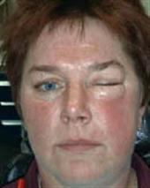
Sodium hypochloride accident
Immediate severe pain for 2-6 minutes.
immediate edema in adjacent soft tissue because of perfusion to the loose connective tissue.
Extension of edema to a large site of the face such as cheeks, peri- orbital region, or lips.
Ecchymosis on skin or mucosa as a result of profuse interstitial bleeding.
Notes:
The unintentional injection of naocl into apical tissue due to wedging of irrigation needle or excessively high pressure in teeth with wide open foramen or root resorption .

Slide 21
Sodium hypochloride accident
Management
inform the patient about the cause and nature of the complication.
Immediately irrigate with normal saline to decrease the soft-tissue irritation by diluting the NaOCl.
Let the bleeding response continue as it helps to flush the irritant out of the tissues.
Notes:
Remain calm

Slide 22
Sodium hypochloride accident
Prophylactic antibiotic coverage for 7 to 10 days to prevent secondary infection or spreading of the present infection.

Slide 23
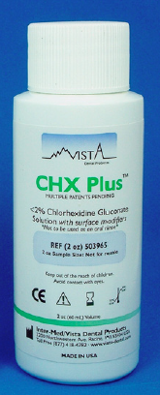
Chlorhexidine (CHX)
Anti microbial properties (broad spctrum antimicrobial agent )
Tissue solvent.
Flush debris.
Lubricant.
Eliminate the smear layer.
Low toxicity level.

Slide 24
Concentration
0.2% is concentration commonly used for chemically plaque control in oral cavity .
2% is concentration used as root canal irrigation.

Slide 25
Limitation
Unable to dissolve remaining necrotic tissue.
Less effective on gram negative than on gram positive.
Unable to remove smear layer.

Slide 26
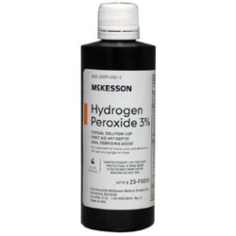
Hydrogen Peroxide H₂O₂
It is a clear, colorless,odorless liquid.
H₂O₂ is active against viruses, bacteria, and yeasts.
It has been particularly popular in cleaning the pulp chamber from blood and tissue remnants, but it has also been used in canal irrigation.

Slide 27
Hydrogen Peroxide H₂O₂
Anti microbial properties (broad spctrum antimicrobial agent )
Tissue solvent.
Flush debris.
Lubricant.
Eliminate the smear layer.
Low toxicity level.

Slide 28
Concentration
It is recommended to use in 3% concentration for endodontic irrigation.
Notes:
Couse higer conc can be dangerous

Slide 29
Limitation
Unable to remove smear layer.
Always use Naocl last because Hydrogen peroxide release of nascent oxygen on contact with organic tissue which may build up pressure on closing tooth and causes pain .
Soft tissue emphysema may occur when hydrogen peroxide irrigant enforced beyond the apical foramen.

Slide 30
MTAD
A mixture of tetracycline isomer, acid, and detergent.
(doxycycline, citric acid, and the detergent Tween-80)
Notes:
The citric acid component in MTAD effectively removed a smear layer. Under these conditions, BioPure MTAD was more aggressive in eroding dentin than EDTA. In another investigation, however, the addition of NaOCl was necessary to achieve dissolution of organic matter.

Slide 31
Anti microbial properties (broad spctrum antimicrobial agent )
Tissue solvent.
Flush debris.
Lubricant.
Eliminate the smear layer.
Low toxicity level.

Slide 32
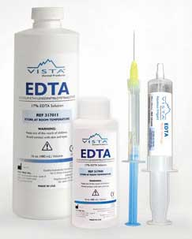
Chelating Agents
EDTA (ethylene-diaminetetra-acetic acid)
The basic purpose of chelating agent is lubrication ,emulsification and holding debris in suspension .

Slide 33
Mechanism of action
EDTA functions by forming calcium chelate solution with calcium ions of dentin which make it more friable and thus dentin become easily to manipulate by instrumentation.

Slide 34
EDTA
17% EDTA ( pH 7 )
EDTA has no antibacterial activity.
It effectively removes smear layer by chelating the inorganic component of the dentine.
Aid in mechanical canal shaping.

Slide 35
The optimal working time of EDTA is 15 minutes, after which time no more chelating action can be expected.

Slide 36
Irrigation method:
It is strongly recommended that the needle lie passively in the canal and not engage the walls.
A 27- or 30-gauge needle is preferred
The solution must be introduced slowly.
The irrigating needle should be bent to allow easier delivery of the solution and to prevent deep penetration of the needle.
Care must be taken with irrigants like sodium hypochlorite to prevent accidents.
Notes:
Allow for irrigant flow back.

Slide 37
Methods for irrigants activation

Slide 38
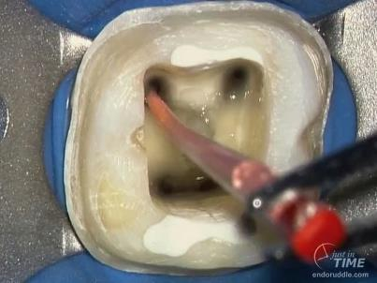
Gutta-percha Points agitation
use of apically fitting gutta-percha cone in an up-and-down motion at the working length. Although this facilitates the exchange of the apical solution, but the overall volume of fresh solution in the apical canal is likely to remain small.
Notes:
The recognition of the difficulty of apical canal irrigation has led to various innovative techniques to facilitate the penetration of solutions in the canal. One of these includes the :Gutta-percha Points

Slide 39
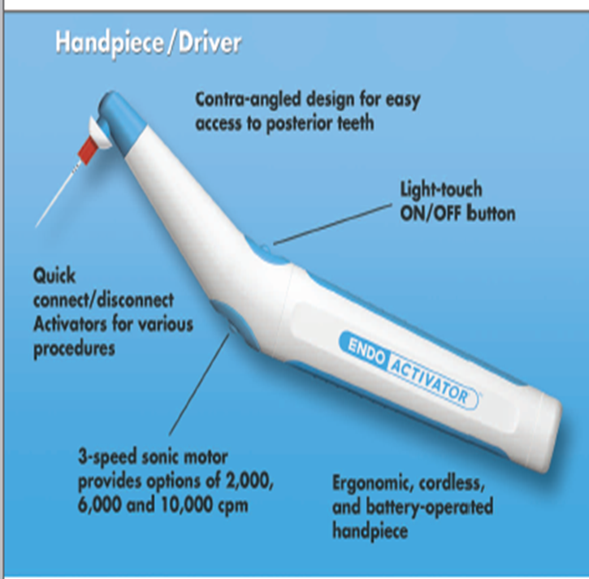
EndoActivator
It is based on sonic vibration (up to 10,000 rpm) of a plastic tip in the root canal. The system has 3 different sizes of tips that are easily attached to the battery operated handpiece that creates the sonic vibrations.
Notes:
Note It does not deliver new irrigant to the canal but it facilitates the penetration and renewal of the irrigant in the canal.

Slide 40
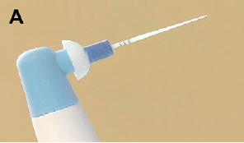
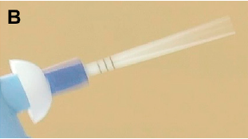
EndoActivator
it allow more irrigant penetration and mechanical cleansing compared with needle irrigation, with no increase in the risk of irrigant extrusion through the apex.

Slide 41
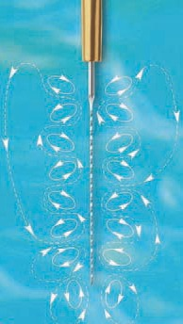
Ultrasound
Ultrasound is sound energy with frequency above 25 KHZ.
Passive ultrasonic irrigation have shown to clean root canals or eliminate bacteria from the walls better than conventional methods.

Slide 42
Mechanism of action
When a small file (size 10-20) is placed freely in the center of the canal following preparation and ultrsonic activation is given . The ulrtasonic energy passage through irrigating solution and exerts its (acoustic streaming effect ).

Slide 43
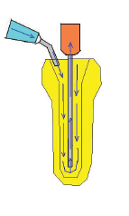
EndoVac
The EndoVac system is based on a negative-pressure approach whereby the irrigant placed in the pulp chamber is sucked down the root canal and back up again through a thin needle with a special design.

Slide 44
Intracanal medicaments
The main use of an intracanal medicament is to help destroy microbes.
1- Phenol. It is an effective medicament in root canal.
2- Camphorated phenol. It is phenol liquefied in camphor. It is less toxic of the phenolic compounds.
3- Camphorated monochloro phenol CMCP It is more toxic than phenol but it is also more active antiseptic but does not last for more than 3 days. It is less irritating than tricresol formalin.
4- Tri cresol formalin. The compound is a mixture of three isomers. It has a powerful antibacterial action that last for up to 7 days.

Slide 45
5- Calcium hydroxide. This is biocompatible and can be used to disinfect the root canal for more than one week. The antimicrobial activity of calcium hydroxide is related to of (OH-) in an aqueous environment. Hydroxyl ions (OH-) are highly oxidant free radicals that show extreme reactivity, reacting with several biomolecules
6- Photoactivated disinfection (PAD)
Is a medical treatment that utilizes light to activate a photosensitizing agent (photosensitizer) in the presence of oxygen. The exposure of the photosensitizer (PS) to light results in the formation of oxygen species, such as singlet oxygen and free radicals, causing localized photodamage and cell death.

Slide 46
Antibiotics in endodontics
Antibiotics are used when infection spreads to the alveolar bone with swelling of the area above the accused tooth and drainage does not relieve the swelling.
Most of the bacterial species involved with endodontic infections are susceptible to penicillins, which make them first-line drugs of choice.
In more serious cases, including life-threatening conditions, combining amoxicillin with clavulanic acid or metronidazole can achieve optimum antimicrobial effects as a result of the extended spectrum of action to include penicillin-resistant strains.
Erythromycin is used in cases of penicillin allergy.
As a conclusion unnecessary use of antibiotics increases the risk for developing resistant species of bacteria.

Slide 47
Thank You

